Slide 1
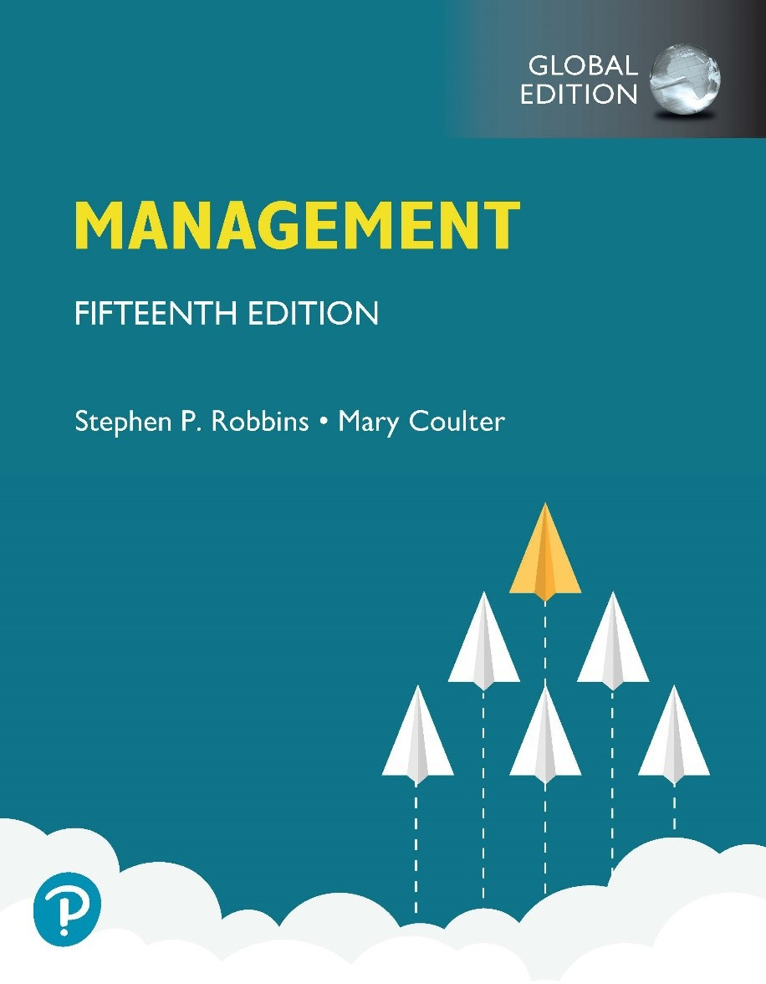
Management
Fifteenth Edition, Global Edition
Chapter 9
Managing Strategy

Slide 2
Learning Objectives
Define strategic management and explain why it’s important.
Explain what managers do during the six steps of the strategic management process.
Describe the three types of corporate strategies.
Describe competitive advantage and the competitive strategies organizations use to get it.

Slide 3
What is Strategic Management?
Strategic management: what managers do to develop the organization’s strategies
Strategies: the plans for how the organization will do what it’s in business to do, how it will compete successfully, and how it will attract and satisfy its customers in order to achieve its goals
Business model: how a company is going to make money

Slide 4
Why is Strategic Management Important?
Has a positive impact on performance
Helps managers decide how to act in face of change and uncertainty
Helps complex and diverse organizations work together

Slide 5
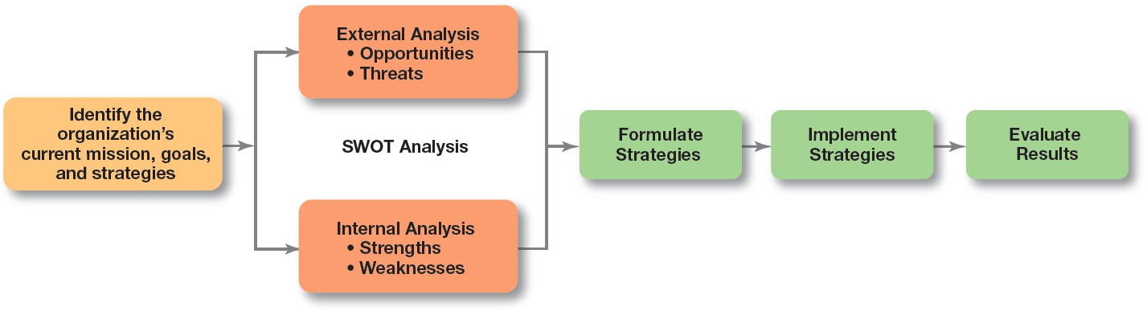

Exhibit 9.1 Strategic Management Process
Exhibit 9.1 illustrates the six-step process of strategic management, which encompasses strategy planning, implementation, and evaluation.

Slide 6
Step 1: Identifying the Organization’s Current Mission, Goals, and Strategies
Mission: the purpose of an organization

Slide 7
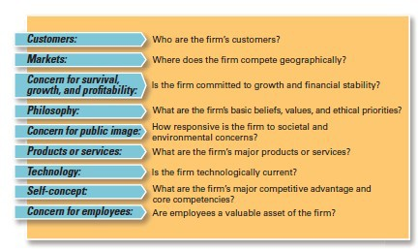
Exhibit 9.2 Components of a Mission Statement

Slide 8
Step 2: Doing an External Analysis
Opportunities: positive trends in the external environment
Threats: negative trends in the external environment

Slide 9
Step 3: Doing an Internal Analysis
Resources: an organization’s assets that are used to develop, manufacture, and deliver products to its customers
Capabilities: an organization’s skills and abilities in doing the work activities needed in its business
Core competencies: the organization’s major value- creating capabilities that determine its competitive weapons

Slide 10
SWOT Analysis
Strengths: any activities the organization does well or its unique resources
Weaknesses: activities the organization does not do well or resources it needs but does not possess
SWOT analysis: an analysis of the organization’s strengths, weaknesses, opportunities, and threats

Slide 11
Step 4: Formulating Strategies
Three main types of strategies managers will formulate:
Corporate
Competitive
Functional

Slide 12
Step 5: Implementing Strategies
No matter how effectively an organization has planned its strategies, performance will suffer if the strategies aren’t implemented properly.

Slide 13
Step 6: Evaluating Results
How effective have strategies been at helping the organization achieve its goals
What adjustments are necessary?

Slide 14
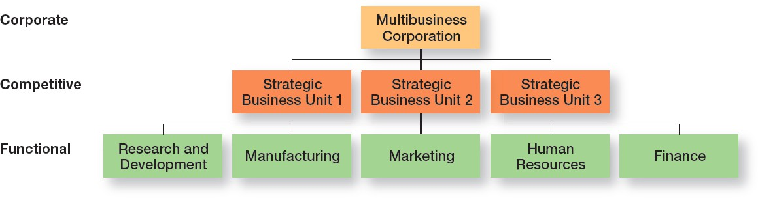
Exhibit 9.3 Types of Organizational Strategies
Exhibit 9.3 shows the three types of strategies organizations use: corporate, competitive, and functional.

Slide 15
What is Corporate Strategy?
Corporate strategy: an organizational strategy that determines what businesses a company is in or wants to be in, and what it wants to do with those businesses

Slide 16
What Are the Types of Corporate Strategy?
Growth strategy: a corporate strategy that’s used when an organization wants to expand the number of markets served or products offered, either through its current business(es) or through new business(es)
Concentration
Vertical integration
Horizontal integration
Diversification

Slide 17
Stability and Renewal Strategies
Stability strategy: a corporate strategy in which an organization continues to do what it is currently doing
Renewal strategy: a corporate strategy designed to address declining performance

Slide 18
How Are Corporate Strategies Managed?
BCG matrix: a strategy tool that guides resource allocation decisions on the basis of market share and growth rate of SBUs
Stars
Cash cows
Question marks
Dogs

Slide 19
Competitive Strategies
Competitive strategy: an organizational strategy for how an organization will compete in its business(es)
Strategic business unit (SBU): the single independent businesses of an organization that formulate their own competitive strategies

Slide 20
The Role of Competitive Advantage
Competitive advantage: What sets an organization apart; its distinctive edge
Competitive advantage can stem from:
Quality
Low cost
Technology
Other factors

Slide 21
Sustaining Competitive Advantage (1 of 2)
Businesses must not only develop a competitive advantage but they must also sustain it.
Economic Moat: sustaining competitive advantage by protecting long-term profits and market share using various means.
Economic moat was a term popularized by Warren Buffett as a way to visualize the concept of keeping a competitive advantage.

Slide 22
Sustaining Competitive Advantage (2 of 2)
Porter’s Five Forces Model:
Threat of new entrants
Threat of substitutes
Bargaining power of buyers
Bargaining power of suppliers
Current rivalry

Slide 23
Choosing a Competitive Strategy
Cost leadership strategy
Differentiation strategy
Focus strategy
Stuck in the middle

Slide 24
Functional Strategies
Functional strategies: a strategy used by an organization’s various functional departments to support the competitive strategy

Slide 25
Examples of Differentiation Strategies
Quality
Innovation strategies
Transfer technology from one division to another
Invest in R&D
Improve the process
First mover: an organization that’s first to bring a product innovation to the market or to use a new process innovation

Slide 26
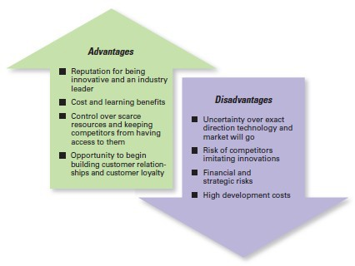
Exhibit 9.4 First Mover Advantages and Disadvantages
Exhibit 9.4 shows the advantages and disadvantages of being a first mover.

Slide 27
Other Differentiation Strategies
Customer Service
Mass Customization
Social Media

Slide 28
Review Learning Objective 9.1
Define strategic management and explain why it’s important.
Strategic management is what managers do to develop the organization's strategies
A business model is how a company is going to make money.

Slide 29
Review Learning Objective 9.2
Explain what managers do during the six steps of the strategic management process.
Identify the current mission, goals, and strategies
Do an external analysis
Do an internal analysis
Formulate strategies
Implement strategies
Evaluate strategies

Slide 30
Review Learning Objective 9.3
Describe the three types of corporate strategies.
Growth strategies: concentration, vertical integration, horizontal integration, and diversification
Stability strategies
Renewal strategies: retrenchment and turnaround
BCG matrix

Slide 31
Review Learning Objective 9.4
Describe competitive advantage and the competitive strategies organizations use to get it.
Competitive advantage
Porter’s five forces model
Porter’s three competitive strategies:
Cost leadership
Differentiation
Focus

